Slide 1
MLOps - Plus
2022

Slide 2
Motivation for MLOps

Slide 3

Machine Learning Engineering (MLE)
Instead of the term MLOps, we can use the definition of Machine Learning Engineering (MLE).
MLE encompasses all stages from data collection, to model building, to make the model available for use by the product or the consumers. MLE is the use of scientific principles, tools, and techniques of machine learning and traditional software engineering to design and build complex computing systems.
The machine learning engineer has to understand how to work with data and be able to contribute to the full life cycle of a ML project.
In addition, the MLE often works with diverse stakeholders.

Slide 4
ML/AI-related risks

Slide 5
Model Risk Mitigation
Complex interactions between models is probably the most challenging source of risk. This class of issue will be a growing concern as ML models become pervasive, and it’s an important potential area of focus for MLOps systems.
Moreover, the total complexity is heavily determined by how the interactions with models are designed at a local scale and governed at an organizational scale. Using models in chains (where a model uses inputs from another model) can create significant additional complexity as well as totally unexpected results.
A number of measures can be implemented to avoid model misbehavior, including examining its inputs and outputs in real time. While training a model, it is possible to characterize its domain of applicability by examining the intervals on which the model was trained and validated.
More sophisticated methods can be used, including anomaly detection to identify records where the model is used outside of its application domain.

Slide 6
Designing ML-powered Software

Slide 7
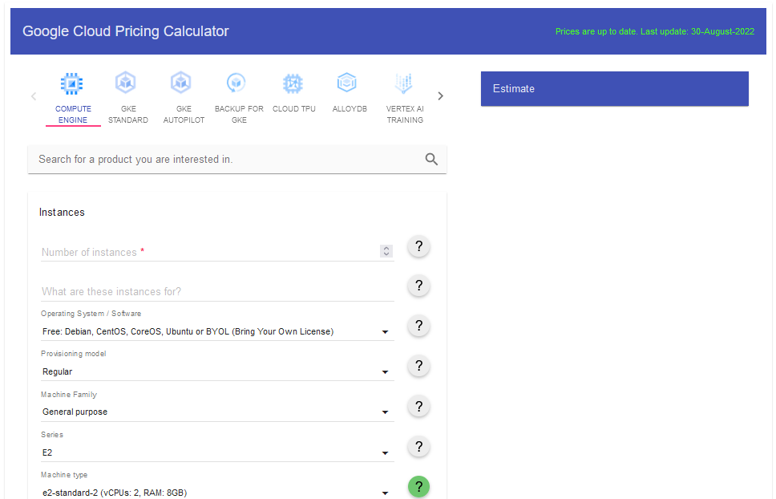
Google Cloud Calculator
With the Google Cloud Pricing Calculator tool, developers will be able to calculate in advance what it will cost to deploy an application on Google’s cloud platform.
The Google Cloud Calculator provides an accurate breakdown of the services and the costs they entail. It should be noted, however, that the prices issued by the calculator are not to be seen as final and only serve as a basis for discussion and negotiation.

Slide 8
Model Engineering

Slide 9
Model Training (Features Engineering)
Feature engineering is the process of taking raw data from the selected datasets and transforming it into “features” that better represent the underlying problem to be solved.
Features are how data is presented to a model, serving to inform that model on things it may not infer by itself.
Examples of how features may be engineered:
Derivatives: Infer new information from existing information
Enrichment: Add new external information
Encoding: Present the same information differently
Combination: Link features together

Slide 10
Experimentation
Experimentation takes place throughout the entire model development process, and usually every important decision or assumption comes with at least some experiment or previous research to justify it.
Data scientists need to be able to quickly iterate through all the possibilities for each of the model building blocks. Fortunately, there are tools to do all of this semiautomatically, where you only need to define what should be tested depending on prior knowledge and the constraints (e.g., computation, budget).
Goals of experimentation include:
Assessing how useful or how good of a model can be built
Finding the best modeling parameters (algorithms, hyperparameters, feature preprocessing, etc.).
Tuning the bias/variance trade-off for a given training cost to fit that definition of “best.”
Finding a balance between model improvement and improved computation costs.

Slide 11
Orchestration Tools

Slide 12
Reproducibility
In general, reproducibility in MLOps also involves the ability to easily rerun the exact same experiment. Data scientists may to have the ability to go back to different “branches” of the experiments—for example, restoring a previous state of a project.
It implies that the model comes with detailed documentation, the data used for training and testing, and with an artifact that bundles the implementation of the model plus the full specification of the environment it was run in.
ML reproducibility must provide relevant metadata and information to reproduce models. Model metadata management includes the type of algorithm, features and transformations, data snapshots, hyperparameters, performance metrics, verifiable code from source code management, and the training environment.
Repeatability also makes debugging much easier.

Slide 13
Reproducibility
All facets of the model need to be documented and reusable, including:
Assumptions: When a data scientist makes decisions and assumptions they should all be explicit and logged.
Randomness: A lot of ML algorithms and processes, such as sampling, make use of pseudo-random numbers.
Data: To get repeatability, the same data must be available.
Settings: All processing that has been done must be reproducible with the same settings.
Results: Data scientists need to be able to compare in-depth analysis of models.
Implementation: Different implementations of the same model can actually yield different models, enough to change the predictions on some close calls.
Environment: the environment in which several of those steps run may be more or less implicitly tied to the results. Preferably, data scientists should make sure that the runtime environment is also repeatable. Given the pace at which ML is evolving, this might require techniques that freeze the computation environments.

Slide 14
Auditability
Auditability is related to reproducibility, but it adds some requirements.
For a model to be auditable, it must be possible to access the full history of the ML pipeline from a central and reliable storage and to easily fetch metadata on all model versions including:
The full documentation
An artifact that allows running the model with its exact initial environment
Test results, including model explanations and fairness reports
Detailed model logs and monitoring metadata

Slide 15
ML Security
Protection against ML-specific cybersecurity attacks is also very important. With models often being trained on sensitive data, data and information security play an important role.
Using the Adversarial ML Threat Matrix might be helpful.
Machine learning introduces a new range of potential threats where an attacker provides malicious data designed to cause the model to make a mistake.
If an attacker can get access to the training data, even partially, then they get control over the system. This kind of attack is traditionally known as a poisoning attack in computer security.
Models can also leak data in many ways. Since the machine learning models can fundamentally be considered a summary of the data they have been trained on, they can leak more or less precise information on the training data.

Slide 16
Documentation
There are two important tools for documentation.
Datasheets
Datasheets record which kind of mechanisms or procedures were used for data collection or whether ethical review procedures took place.
Sometime dataset be accompanied with a datasheet that documents its motivation, composition, collection process, recommended uses, and so on. Datasheets for datasets have the potential to increase transparency and accountability.
More: https://arxiv.org/pdf/1803.09010.pdf
Model cards
Model Cards complement Datasheets and provide information about the development of a model, the assumptions that have been made, and expectations about model behavior.
Model cards are short documents accompanying trained machine learning models that provide benchmarked evaluation in a variety of conditions, such as across different cultural, demographic, or phenotypic groups.
In addition to model evaluation results, model cards should detail the motivation behind chosen performance metrics, group definitions, and other relevant factors.
More: https://arxiv.org/pdf/1810.03993.pdf

Slide 17
Model Operationalization

Slide 18
Artifacts
Once the code and data is in a centralized repository, a testable and deployable bundle of the project must be built. These bundles are usually called artifacts in the text of CI/CD.
Each of the following elements needs to be bundled into an artifact that goes through a testing pipeline and is made available for deployment to production:
Code for the model and its preprocessing
Hyperparameters and configuration
Training and validation data
Trained model in its runnable form
An environment including libraries with specific versions, environment variables, etc.
Documentation
Code and data for testing scenarios

Slide 19
Deployment Strategies
When sending a new model version to production, the first consideration is often to avoid downtime, in particular for real-time scoring.
The basic idea is that rather than shutting down the system, upgrading it, and then putting it back online, a new system can be set up next to the stable one, and when it’s functional, the workload can be directed to the newly deployed version. This deployment strategy is called blue-green—or sometimes red-black—deployment.
There are many variations and frameworks (like Kubernetes) to handle this natively.
Another more advanced solution to mitigate the risk is to have canary releases (also called canary deployments). The idea is that the stable version of the model is kept in production, but a certain percentage of the workload is redirected to the new model, and results are monitored.
Canary testing can be used to carry out A/B testing, which is a process to compare two versions of an application in terms of a business performance metric.

Slide 20
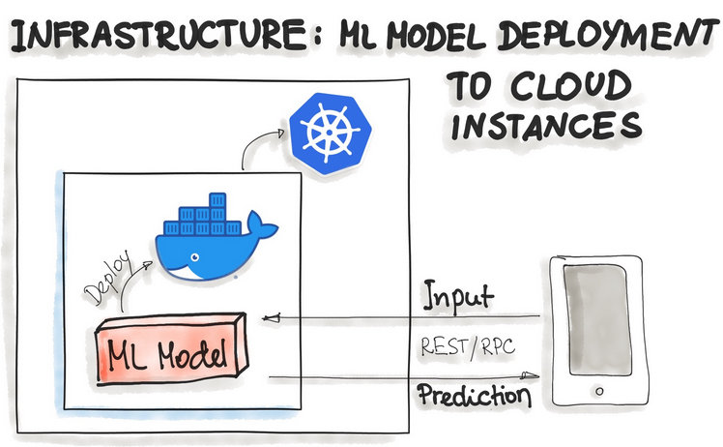
Deployment Strategies
There are different ways for wrapping trained models as deployable services. For example:
Deploying ML Models as Docker Containers
As of now, there is no standard, open solution to ML model deployment. As ML model inference being considered stateless, lightweight, and idempotent, containerization becomes the de-facto standard for delivery. This means we deploy a container that wraps an ML model inference code.
One ubiquitous way is to package the whole ML tech stack (dependencies) and the code for ML model prediction into a Docker container.

Slide 21
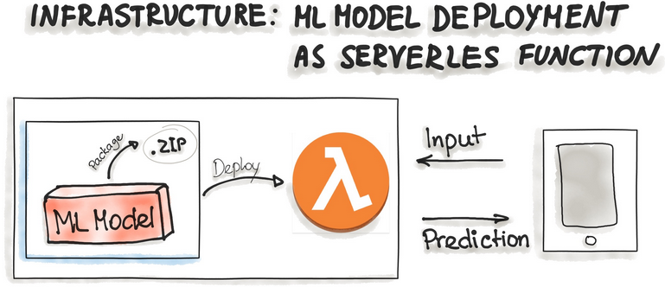
Deployment Strategies
Deploying ML Models as Serverless Functions
Various cloud vendors already provide machine-learning platforms, and you can deploy your model with their services. Examples are Amazon AWS Sagemaker, Google Cloud AI Platform, Azure Machine Learning Studio, and IBM Watson Machine Learning. Commercial cloud services also provide containerization of ML models such as AWS Lambda and Google App Engine servlet host.
In order to deploy an ML model as a serverless function, the application code and dependencies are packaged into .zip files, with a single entry point function. This function then could be managed by major cloud providers such as Azure Functions, AWS Lambda, or Google Cloud Functions.

Slide 22
Concept Drift
How often should models be retrained?
Unfortunately, there is no easy answer, as this question depends on many factors, including:
The domain: Models in areas like cybersecurity or real-time trading need to be updated regularly to keep up with the constant changes inherent in these fields. Physical models, like voice recognition, are generally more stable, because the patterns don’toften abruptly change.
The cost: Organizations need to consider whether the cost of retraining is worth the improvement in performance.
The model performance: the model performance is restrained by the limited number of training examples, and thus the decision to retrain hinges on collecting enough new data.

Slide 23
Model Monitoring
It’s important to note that the goal of notifications is not necessarily to kick off an automated process of retraining, validation, and deployment. Model performance can change for a variety of reasons, and retraining may not always be the answer. The point is to alert the data scientist of the change; that person can then diagnose the issue and evaluate the next course of action.
Practically, every deployed model should come with monitoring metrics and corresponding warning thresholds to detect meaningful business performance drops as quickly as possible.

Slide 24
Model Monitoring
A approach to monitor its performance degradation: ground truth evaluation.
Ground truth retraining requires waiting for the label event. With the new ground truth collected, the next step is to compute the performance of the model based on ground truth and compare it with registered metrics in the training phase. When the difference surpasses a threshold, the model can be deemed as outdated, and it should be retrained.
The metrics to be monitored can be of two varieties:
Statistical metrics like accuracy, ROC AUC, log loss, etc.
Business metrics, like cost-benefit assessment.
But ground truth is not always immediately, or even imminently, available.
For some types of models, teams need to wait months (or longer) for ground truth labels to be available, which can mean significant economic loss if the model is degrading quickly.

Slide 25
Model Monitoring
Another approach to monitor its performance degradation: input drift detection.
It's a more practical approach.
The resulting distribution shift is called a drift.
Input drift is based on the principle that a model is only going to predict accurately if the data it was trained on is an accurate reflection of the real world.
The beauty of this approach is that all the data required for this test already exists, so there is no need to wait for ground truth or any other information.
Identifying drift is one of the most important components of an adaptable MLOps strategy, and one that can bring agility to the organization’s enterprise.

Slide 26
Model Monitoring
There are two common approaches to apply the input drift detection.
Univariate statistical tests
This method requires applying a statistical test on data. The basic approaches rely on these two tests:
For continuous features, the Kolmogorov-Smirnov test: to check whether two samples come from the same distribution.
For categorical features, the Chi-squared test: to check whether the observed frequencies for a categorical feature match the expected frequencies
Domain classifier
Data scientists train a model that tries to discriminate between the original dataset and the development dataset. In other words, they stack the two datasets and train a classifier that aims at predicting the data’s origin. The performance of the model (its accuracy, for example) can then be considered as a metric for the drift level.
If this model is successful in its task it implies that the data used at training time and the new data can be distinguished, so it’s fair to say that the new data has drifted.

Slide 27
Model Monitoring
An event log of a machine learning system is a record with a timestamp and the following information.
Model metadata: Identification of the model and the version.
Model inputs: Feature values of new observations, which allow for verification of whether the new incoming data is what the model was expecting and thus allowing for detection of data drift.
Model outputs: Predictions made by the model that give a concrete idea about the model performance in a production environment.
System action: the more common situation than the system will take an action based on this prediction.
Model explanation: In some highly regulated domains such as finance or healthcare, predictions must come with an explanation. This kind of information is usually computed with techniques such as Shapley value computation and should be logged to identify potential issues with the model

Slide 28
Model Evaluation
A main modes of online evaluation is Champion/challenger (otherwise known as shadow testing), where the candidate model shadows the deployed model and scores the same live requests.
Champion/challenger involves deploying one or several additional models (the challengers) to the production environment. These models receive and score the same incoming requests as the active model (the champion). The predictions are simply logged for further analysis.
This setup allows for two things:
Verification that the performance of the new models is better than, or at least as good as, the old model. Because the two models are scoring on the same data, there is a direct comparison of their accuracy in the production environment.
Measurement of how the new models handle realistic load.
To be able to compare the champion and the challenger models, the same information must be logged for both, including input data, output data, processing time, etc.

Slide 29
Model Governance

Slide 30
Model Governance
Governance is the set of controls placed on a business to ensure that it delivers on its responsibilities to all stakeholders, from shareholders and employees to the public and national governments.
These responsibilities include financial, legal, and ethical obligations.
The operationalization of ML models is also the use of MLobliges companies responsibility and compliance with legal requirements.
To fulfill these obligations, a company requires processes through which it is able to:
control access to ML models
put guidelines and legal requirements into practice
track interactions with the ML models and their results
document the foundation of an ML model (stakeholders, business context, training data, feature selection, guidelines for model reproduction, choice of parameters, results of model evaluation and validation)

Slide 31
Governments
Recently, governments across the world have imposed regulations to protect the public from the impact of the use of personal data by businesses.
The 2016 EU General Data Protection Regulation (GDPR)
The 2018 California Consumer Privacy Act (CCPA)
Governments are now starting to turn their regulatory eye to ML specifically, hoping to mitigate the negative impact of its use.
ML is rapidly being embedded in decision-making systems that impact every aspect of our lives. The European Union is leading the way with planned legislation to define the acceptable uses of various forms of AI.

Slide 32
Governments
Public opinion determines what products people buy, where they invest their money.The general public needs to be reassured that ML is fair. Right now, opinion on ML is in the balance.
But there have also been well-publicized scandals that have rocked the public’s acceptance of this technology. The Facebook-Cambridge Analytica affair, where the companies used the power of ML to manipulate public opinion on social media, shocked the world. This looked like ML with explicitly malicious intent.
If businesses and governments want to reap the benefits of ML, this means developing strong governance of their MLOps process. They must assess the risks, determine their own set of fairness values, and then implement the necessary process to manage them.
Those responsible for MLOps must manage the inherent tension between different user profiles, striking a balance between getting the job done efficiently and protecting against all possible threats. This balance can be found by assessing the specific risk of each project and matching the governance process to that risk level.

Slide 33
Governance to MLOps
Governance initiatives in MLOps fall into one of two categories:
Data Governance
A framework for ensuring appropriate use and management of data ML projects usually involve significant pipelines, consisting of data cleaning, combination, and transformation steps.
Data governance tools that can address these problems are in their infancy.
Process Governance
Focuses on formalizing the steps in the MLOps process and associating actions with them. Typically these actions are reviews, sign-offs, and the capture of supporting materials, such as documentation.
The aim is twofold: to enable oversight from outside of the strict MLOps process. Auditors, risk managers, compliance officers, and the business as a whole all have an interest in being able to track progress and review decisions at a later stage.

Slide 34
GDPR and CCPA Data Privacy Regulations
GDPR attempts to protect personal data from industrial misuse with a goal of limiting the potential discrimination against individuals.
The GDPR sets out principles for the processing of personal data, and processing includes the collection, storage, alteration, and use of personal data.
GDPR Principles:
Lawfulness, fairness, and transparency
Purpose limitation
Data minimization
Accuracy
Storage limitation
Integrity and confidentiality (security)
Accountability
The California Consumer Privacy Act (CCPA) is quite similar to GDPR in terms of who and what is protected, although the scope, territorial reach, and financial penalties are all more limited.

Slide 35
A Template for MLOps Governance
How to implement a robust governance framework of MLOps, 8 steps:
Understand and classify the analytics use cases.
Identify the key distinguishing features of the different use cases
Establish an ethical position
Take is a trade-off between the cost to implement the position and public perception.
Establish responsibilities.
Determine governance policies.
Integrate policies into the MLOps process.
Select the tools for centralized governance management.
Engage and educate.
Every individual needs to learn what they must do, when, and how. This exercise will require considerable documentation, training, and time.
Monitor and refine.
Measuring success requires metrics and checks

Slide 36
MLOps Infrastructure

Slide 37
Building vs Buying vs Hybrid MLOps Infrastructure
Now, should you build or buy your infrastructure? Maybe you should go hybrid?
Tech companies that want to survive long-term usually have in-house teams and build custom solutions. If they have the skills, knowledge, and tools to tackle complex problems, there’s nothing wrong with that approach.
But there are other factors that are worth taking into account, like:
time and effort
human resources
time to profit
opportunity cost.

Slide 38
MLOps Infrastructure
Build
Building your own platform and infrastructure will take more and more of your focus and attention as demand increases. The time that could be spent on model R&D and data collection will be taken by infrastructure management. This isn’t great unless it’s part of your core business (if you’re a cloud service provider, PaaS or IaaS).
Buy
Buying a fully managed platform gives you great flexibility and scalability, but then you’re faced with compliance, regulations, and security issues.
Hybrid
Hybrid cloud infrastructure for MLOps is the best of both worlds, but it poses unique challenges, so it’s up to you to decide if it fits your business model.

Slide 39
Hybrid MLOps Infrastructure
Some companies have been entrusted with private & sensitive data. It can’t leave their servers because in the chance of a small vulnerability, the ripple effect would be catastrophic. This is where Hybrid cloud infrastructure for MLOps comes in.
Today’s infrastructure is a mix of cloud and on-prem.
The vast majority of cloud stakeholders (96%) face challenges managing both on-prem and cloud infrastructure.
Cloud infrastructure is increasingly popular, but it’s still rare to find a large company that has completely abandoned on-premise infrastructure (most of them for obvious reasons, like sensitive data).
Hybrid cloud adoption are growing. Hybrid cloud environments add an additional layer of complexity that makes managing IT even more challenging.

Slide 40
Cloud Centers of Excellence (CCoEs)
A Cloud Center of Excellence (CCoE) is a cross-functional team of people responsible for developing and managing the cloud strategy, governance, and best practices that the rest of the organization can leverage to transform your business using the cloud.
The CCoE leads the organization as a whole in cloud adoption, migration, and operations. It may also be called a Cloud Competency Center, Cloud Capability Center, or Cloud Knowledge Center.
CCoE adoption is increasing

Slide 41
Cloud Centers of Excellence (CCoEs)
In companies CCoEs can take on many forms.
For some companies it is an official team with a formal reporting structure and clear responsibilities for decision making. Other companies have teams that manage aspects of cloud strategy, but with limited responsibilities.
Many companies, especially those early in their adoption of cloud, have an informal approach to CCoE. A typical approach includes team members who have not been assigned specific responsibilities. However, within the group, there may be experts that are generally acknowledged as owning the functions.

Slide 42
AI maturity

Slide 43
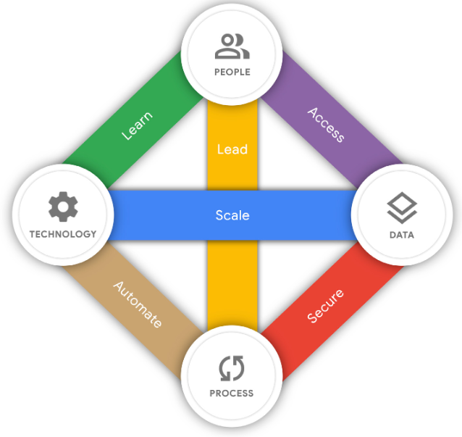
Google Cloud’s AI Adoption
With Google Cloud’s AI Adoption Framework, you’ll be able to create and evolve your own transformative AI capability. You’ll have a structure for building scalable AI capabilities to create better insights from big data with powerful algorithms across the entire business.
Google Cloud’s AI Adoption Framework is anchored in the familiar rubric of people, process, technology, and data. The interplay between these four key areas gives rise to six themes: Learn, Lead, Access, Scale, Automate, and Secure.

Slide 44
AI maturity Themes
Learn concerns the quality and scale of learning programs to upskill your staff, hire external talent, and augment your data science and ML engineering staff with experienced partners.
Lead concerns the extent to which your data scientists are supported, and the degree to which the data scientists are cross-functional, collaborative, and self-motivated.
Access concerns the extent to which your organization recognizes data management as a key element to enable AI and the degree to which data scientists can share, discover, and reuse data and other ML artifacts.
Scale concerns the extent to which you use cloud-native ML services that scale with large amounts of data and large numbers of data processing and ML jobs, with reduced operational overhead.
Secure concerns the extent to which you understand and protect your data and ML services from unauthorized and inappropriate access.
Automate concerns the extent to which you are able to deploy, execute, and operate technology for data processing and ML pipelines in production efficiently, frequently, and reliably.

Slide 45
AI maturity Phases
For each theme, current business practices will fall into one of the following phases: tactical, strategic, transformational.
Tactical
The initial phase, known as Tactical, denotes that the organizations explore the capabilities of ML/AI technologies. The reasonable way is to start with non-critical use cases and short-term projects. Furthermore, all processes are mainly manual because there is little to no MLOps infrastructure and ML skills are being developed.
At this phase, too, there may be no process to scale solutions consistency, nor the skill set to solve complex analytics problems.

Slide 46
AI maturity Phases
Strategic
The next phase, called Strategic, implies that business goals coordinate the amount of ML use cases and parts of the processes are automated. Typically, there are basic ML skills in the team and basic infrastructure to get ML models into production. The main distinction to the previous phase is utilizing pipelines for data preparation and model training. Additionally, the ML system provides end points, such as REST API, to expose ML models to the target application. Basic ML monitoring and alerting functionality are in place as well.
Transformational
Organizations use ML to stimulate innovation, support agility and help to cultivate a culture where experimentation and learning is continuous and encouraged. In this phase, ML is productionized as a fully automated process, which implies a sophisticated data platform, widely adopted common patterns for ML development, and CI/CT/CD practices. Organizations utilize advanced MLOps components, such as feature store, ML model and data versioning, and model monitoring and alerting to trigger model re-training.

Slide 47
Data mesh

Slide 48
Before: Central Data Team
Many organizations have invested in a central data lake and a data team with the expectation to drive their business based on data.
However, they notice that the central data team often becomes a bottleneck. The team cannot handle all the analytical questions of management.
They need to spend too much time fixing broken data pipelines after operational database changes. The data team has to discover and understand the necessary domain data. For every question, they need to learn domain knowledge to give meaningful insights.
Organizations have also invested in domain-driven design, autonomous domain teams (also known as stream-aligned teams or product teams) and a decentralized microservice architecture.
These domain teams own and know their domain, including the information needs of the business. They design, build, and run their web applications and APIs on their own.

Slide 49
Why Data mesh
With the eventual growth of the organization, the situation of the domain teams and the central data team becomes worse.
A way out of this is to shift the responsibility for data from the central data team to the domain teams. This is the core idea behind the data mesh concept, born in 2019: Domain-oriented decentralization for analytical data.
The data mesh architecture is a decentralized approach that enables domain teams to perform cross-domain data analysis on their own and interconnects data, similar to APIs in a microservice architecture.

Slide 50
4 Data mesh principles
Domain ownership: The domain teams take responsibility for their data. Following the domain-driven distributed architecture, analytical and operational data ownership is moved to the domain teams, away from the central data team.
Data as a product: This principle means that there are consumers for the data beyond the domain. The domain team is responsible for satisfying the needs of other domains by providing high-quality data. Domain data should be treated as any other public API.
Self-serve data infrastructure platform: A dedicated data platform team provides domain-agnostic functionality, tools, and systems to build, execute, and maintain interoperable data products for all domains. With its platform, the data platform team enables domain teams to seamlessly consume and create data products
Federated governance: The federated governance principle achieves interoperability of all data products through standardization. The main goal of federated governance is to create a data ecosystem with adherence to the organizational rules and industry regulations.

Slide 51
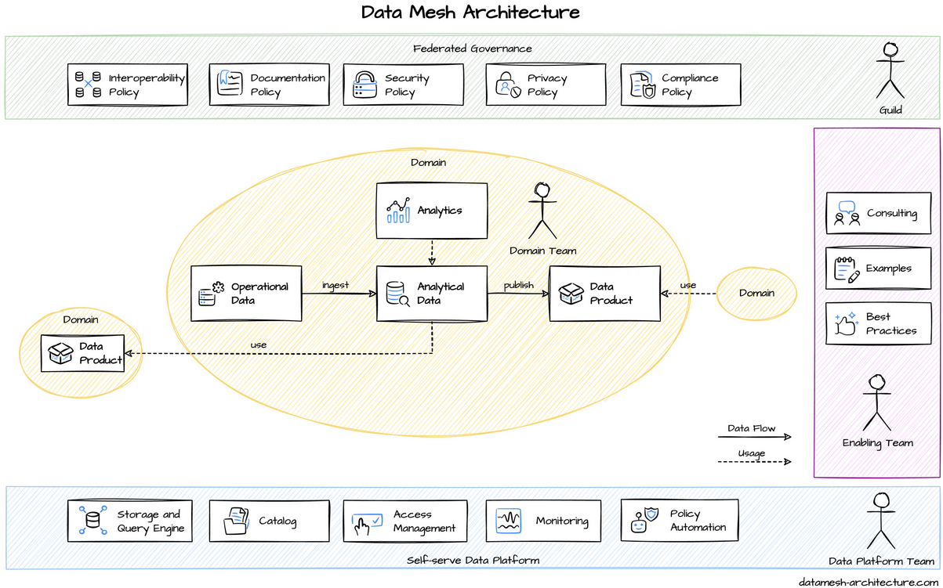
Data mesh Architecture

Slide 52
Technology
There are a lot of different ways to implement a data mesh architecture.
Here is a selection of typical tech stacks that we saw:
Google Cloud BigQuery
AWS S3 and Athena
Azure Synapse Analytics
dbt and Snowflake
Starburst Enterprise (TBD)
Databricks (TBD)

Slide 53
Cloud Providers

Slide 54
Cloud Providers
Spending on cloud infrastructure services reached a record $30 billion in the second quarter of 2020, with Amazon Web Services (AWS), Microsoft, and Google Cloud accounting for half of customer spend.
These companies invest in research & development of specialized hardware, software, and SaaS applications, but also MLOps software.
Two great examples come to mind:
AWS with its Sagemaker, a fully managed end-to-end cloud ML-platform that enables developers to create, train, and deploy machine-learning models in the cloud, embedded systems, and edge-devices.
Google with its recently announced AI Platform Pipelines for building and managing ML pipelines, leveraging TensorFlow Extended (TFX’s) pre-built components and templates that do a lot of model deployment work for you.

Slide 55
End-to-end MLOps solution
These are fully managed services that provide developers and data scientists with the ability to build, train, and deploy ML models quickly.
Amazon
Amazon Sagemaker, a suite of tools to build, train, deploy, and monitor machine learning models.
https://aws.amazon.com/it/sagemaker/
Microsoft Azure
Azure Machine Learning to build, train, and validate reproducible ML pipelines
https://azure.microsoft.com/en-us/services/machine-learning/
Azure Pipelines to automate ML deployments
https://azure.microsoft.com/en-us/services/devops/pipelines/
Azure Monitor to track and analyze metrics
https://docs.microsoft.com/en-us/azure/azure-monitor/overview
Azure Kubernetes Services and other additional tools
https://azure.microsoft.com/en-us/services/kubernetes-service/

Slide 56
End-to-end MLOps solution
Google Cloud
Dataflow to extract, validate, and transform data as well as to evaluate models
https://cloud.google.com/dataflow
AI Platform Notebook to develop and train models
https://cloud.google.com/vertex-ai-workbench
Cloud Build to build and test machine learning pipelines
TFX to deploy ML pipelines
https://www.tensorflow.org/tfx
Kubeflow Pipelines to arrange ML deployments on top of Google Kubernetes Engine (GKE).
https://www.kubeflow.org/docs/components/pipelines/introduction/
https://cloud.google.com/kubernetes-engine

Slide 57
MLOps Stack Template

Slide 58
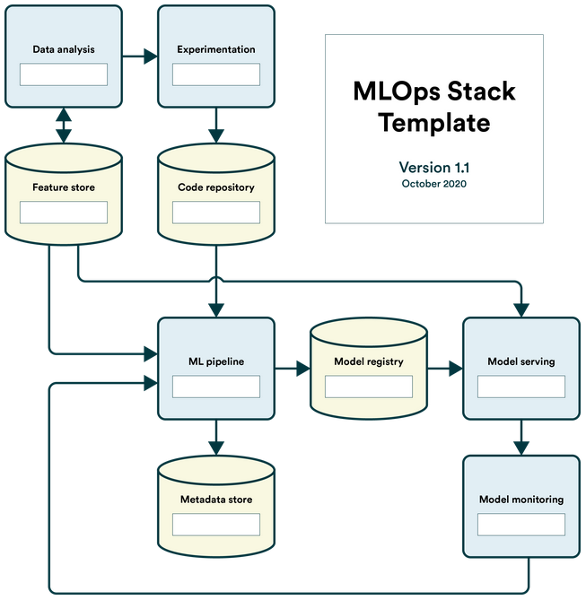
MLOps Stack Template
To make it easier to consider what tools your organization could use to adopt MLOps, there is MLOps Stack Templete, a simple template that breaks down a machine learning workflow into components.
As a machine learning practitioner, you'll have a lot of choices in technologies. First, some technologies cover multiple components, while others are more singularly focused. Second, some tools are open-source and can be implemented freely, while others are proprietary but save you the implementation effort.
Download the MLOps Stack Template
https://valohai.com/assets/files/mlops-stack.pdf

Slide 59
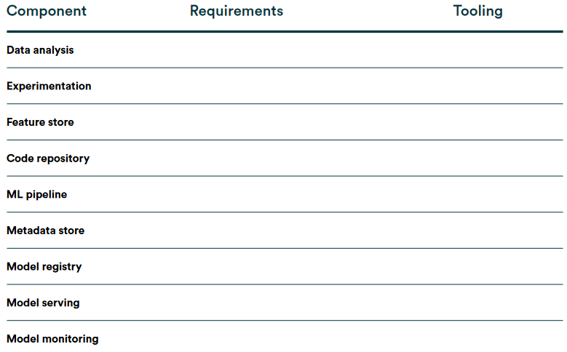
9 Components
The MLOps Stack template is loosely based on Google's article on MLOps and continuous delivery
https://cloud.google.com/architecture/mlops-continuous-delivery-and-automation-pipelines-in-machine-learning
But this tried to simplify the workflow to a more manageable abstraction level.
There are nine components in the stack which have varying requirements depending on your specific use case.

Slide 60
MLOps Stack Canvas

Slide 61
MLOps Stack Canvas
This canvas condenses the main elements of a whole technology stack for an ML application into a single page.
This framework guides the development teams through the MLOps building blocks and lets them answer the MLOps infrastructure-related questions and identify the necessary tools chain.
The purpose of the MLOps Stack Canvas is to help you to structure workflows, architecture, and infrastructure components for the MLOps stack in the ML project.
The scope of MLOps Stack Canvas:
Planning the cost of the infrastructure components for the MLOps stack by considering: Data and code, ML model, and metadata management.
Planning the cost of the orchestration of the ML system to manage its life-cycle and maintainability by considering: CI/T/D for ML assets, monitoring to ensure the ML, alerting to deal with model failures.
Designing the ML system to fulfill: Reproducibility, reliability and efficiency.

Slide 62
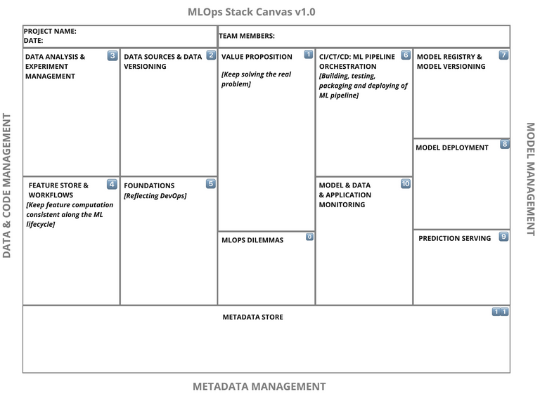
MLOps Stack Canvas
It consists of 3 main areas: Data and Code Management, Model Management, and Metadata Management. Each of these contains its own blocks.
Value Proposition
Data Source and Data Versioning
Data Analysis and Experiment Management
Feature Store and Workflows
Foundations (Reflecting DevOps)
CI/CT/CD: ML Pipeline Orchestration
Model Registry and Model Versioning
Model Deployment
Prediction Serving
ML Model, Data, and System Monitoring

Slide 63
3 Dilemmas of MLOps
There are also organizational aspects of MLOps, which belong to the general discussion about building the ML projects’ infrastructure.
Tooling: Should we buy, use existing open-source or build in-house tools for any of the MLOps components? What are the risks, trade-offs, and impacts of each of the decisions?
Platforms: Should we agree on one MLOps platform or create a hybrid solution? What are the risks, trade-offs, and impacts of each of the decisions?
Skills: How expensive is it to either acquire or educate our own machine learning engineering talents?

Slide 64
Architecture Decision

Slide 65
Architecture Decision
An Architectural Decision (AD) is a software design choice that addresses a functional or non-functional requirement that is architecturally significant.
An Architecturally Significant Requirement (ASR) is a requirement that has a measurable effect on a software system’s architecture and quality.
An Architectural Decision Record (ADR) captures a single AD, such as often done when writing personal notes or meeting minutes; the collection of ADRs created and maintained in a project constitute its decision log.
ARD is a brief description of the architectural decision. Use a lightweight text formatting language like Markdown or Textile. ADRs will be numbered sequentially and monotonically. Numbers will not be reused.
All these are within the topic of Architectural Knowledge Management (AKM).

Slide 66
Architectural Decision Records
A “lightweight” ADR consists of:
Title: These documents have names that are short noun phrases.
Status: What is the status, such as proposed, accepted, rejected, deprecated, superseded, etc.?
Context: A short description of the problem. This section describes the forces at play, including technological, political, social, and project local. These forces are probably in tension, and should be called out as such.
Decision: Describe the actual architectural decision with a detailed explanation.
Consequences: This section provides any implications of the architecture decision. This section is also a good place to discuss any architectural trade-offs. A particular decision may have positive, negative, and neutral consequences, but all of them affect the team and project in the future.

Slide 67

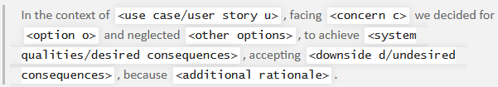
Y-statement
To reduce design documentation effort, we experimented with lean, minimalistic documentation.
One approach was our (WH)Y approach, that reduces the documentation to a statement in the Y-statement.
In short, the Y-statement is as follows:
The long form of it is as follows (extra section “because”):

Slide 68
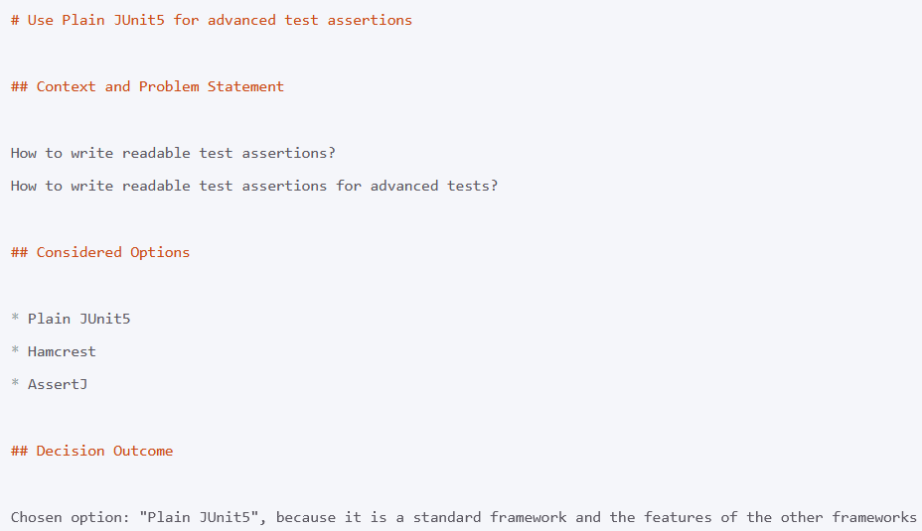
MADR
The Markdown Architecture Decision Records.
MADR is a lean template to capture any decisions in a structured way. The template originated from capturing architectural decisions and developed to a template allowing to capture any decisions taken.
There are debates what is an architecturally-significant decision and which decisions are not architecturally significant. Since we believe that any (important) decision should be captured in a structured way, we offer the MADR template to capture any decision.

Slide 69
Data Product Canvas

Slide 70
Designing Data Products
Conceptually, a mesh is a graph, a network, consisting of nodes and connecting edges. Each node in a data mesh is called data product. Every data product exists within a bounded context and one bounded context might contain several data products.
A data product is an autonomous, read-optimized, standardized data unit containing at least one Domain Dataset, created for satisfying user needs.
Any data representation that has value for its consumers can be a data product. For example:
A database table or view
Raw unstructured files: e.g., images or videos
Data stream of data entities from a transaction system
Data stream representing the history of changes to the application
REST API: Read-optimized data exposed from applications
Features for the machine learning models

Slide 71
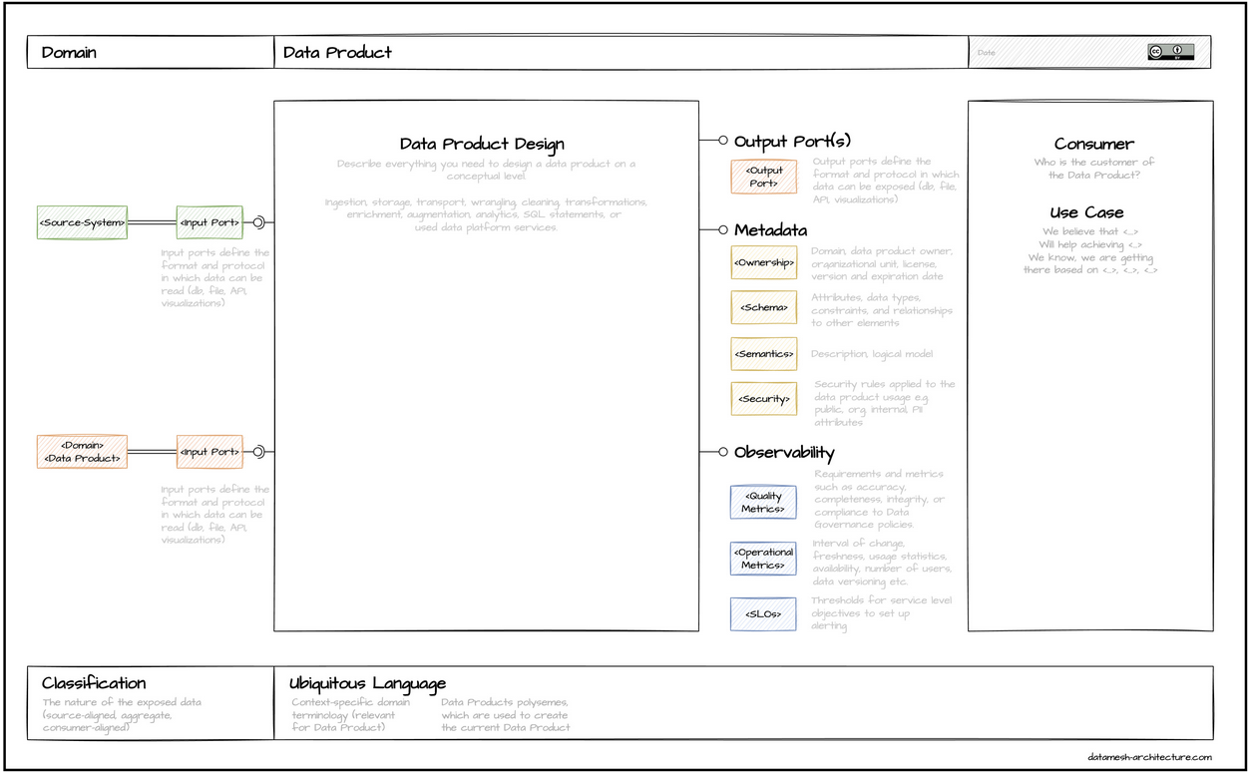
Data Product Canvas

Slide 72
Data Product Canvas
A Data Product Canvas is a visual framework that guides your team through the data product specification.
The Data Product Canvas consists of ten building blocks:
Domain
Data Product Name
Consumer and Use Case: describes the reason behind the existence of the data product.
Output Port: define the format and consumption protocol in which data can be exposed.
Metadata
Input Ports: describes the input data for the future data product.
Data Product Design: to specify everything between the input and output ports.
Observability: Quality Metrics, operational Metrics.
Ubiquitous Language: a common language that is shared between everyone involved in the project.
Classification: specify the nature of the exposed data

Slide 73
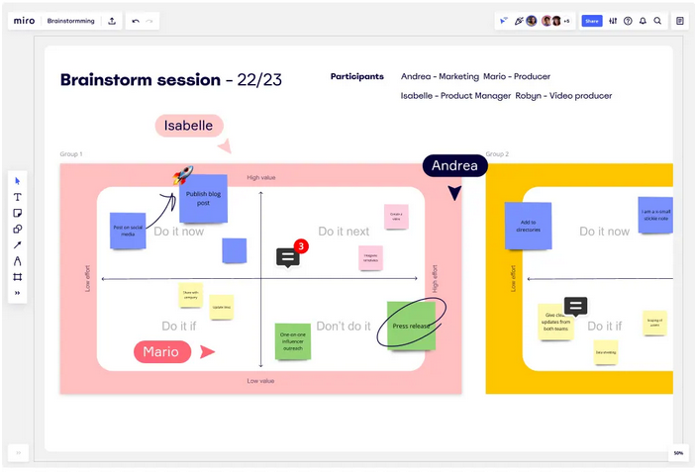
Template
The proposed canvas is suitable for working collaboratively on data products design.
The canvas might be easily used either plotted on paper or with the common online whiteboards like Miro or Mural.
Once your organization has created a collection of data products using the proposed data product canvas, you can start connecting all data products and produce an actual mesh.

Slide 74
dbt and Snowflake

Slide 75
dbt and Snowflake
dbt has emerged as the default framework to engineer analytical data. This is where you define and test your models.
Compare it with Spring Boot in the microservices world.
dbt has adapters for most data warehouses, databases, and query engines.
Snowflake is a modern data warehouse. The key concepts to store and access data are tables and views, along with SQL queries. Snowflake can be compared with Google BigQuery, AWS Redshift and Azure Synapse.
Snowflake is a great fit for dbt.
Snowflake is built on cost-efficient object storage services to store data and compute instances to execute queries and DML operations.
DML(Data Manipulation Language) operations: Inserting and Updating, Upserting, Merging, Deleting, Restoring Deleted records and Converting Leads.

Slide 76
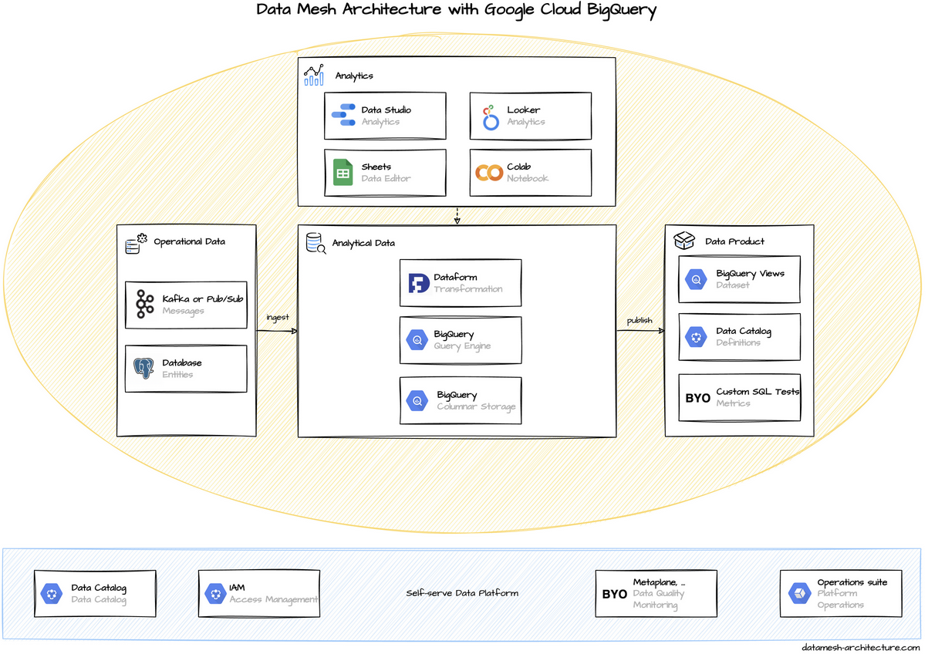
Architecture

Slide 77
Architecture
Dbt
Trasformation: to transform, clean, and aggregate data within your data warehouse. Instead, models are defined, configured, and documented in simple YML or YAML structures.
YAML ("Yet Another Markup Language") is a text format used to specify data related to configuration.
Definition: a model should be tagged as data_product.
Test: to verify data when running any transformation. More complex tests are written as SQL statements
Snowflake
Query Engine
Object storage, Storage: stores data in tables that are logically organized in databases and schemas.
Dashboard: Snowflake`s Web UI Snowsight has some basic support to visualize data in dashboards.
Dataset
Access Management: As permission management might get complex.

Slide 78
Google Cloud BigQuery

Slide 79
Google Cloud BigQuery

Slide 80
Google Cloud BigQuery
Google Cloud Platform is a Serverless, highly scalable, and cost-effective multicloud data warehouse designed for business agility.
Many Data Mesh implementations rely on Google Cloud Platform (GCP) as a common infrastructure, at least for analytical data.
Everything is available as developer-friendly self-service. The on-demand query performance of BigQuery is remarkable, especially for large data sets.
BigQuery is the central component for storing analytical data. BigQuery is a columnar data store and can perform efficient JOIN operations with large data sets.
Data Products are usually simple BigQuery tables or views in a special dataset. The access to these data is managed by the domain team with Google IAM roles.

Slide 81
Features
Serverless: you can focus on data and analysis rather than worrying about upgrading, securing, or managing the infrastructure.
Built-in ML and AI integrations: Besides bringing ML to your data with BigQuery ML, integrations with Vertex AI and TensorFlow enable you to train and execute powerful models on structured data in minutes, with just SQL.
Real-time analytics: making your latest business data immediately available for analysis.
Real-time change data capture and replication: Synchronize data across heterogeneous databases, storage systems, and applications reliably and with minimal latency.
Automatic high availability: BigQuery transparently and automatically provides highly durable, replicated storage in multiple locations
Standard SQL: BigQuery supports a standard SQL.
Materialized Views: allowing you to quickly get answers to your questions.
Storage and compute separation: to choose the storage and processing solutions.
Automatic backup and easy restore: BigQuery automatically replicates data and keeps a seven-day history of changes.
BigQuery data transfer service: The BigQuery Data Transfer Service automatically transfers data from external data sources.

Slide 82
Google Dataplex

Slide 83
Announcement
Google announced Dataplex to centrally manage, monitor and govern data and promotes it for data mesh use cases.
Dataplex is an intelligent data fabric that helps you unify distributed data and automate data management and governance across that data to power analytics at scale.
Dataplex enables standardization and unification of metadata, security policies, governance, classification, and data lifecycle management across this distributed data.
Dataplex enables you to unify data–distributed across data lakes, data warehouses, and data marts.

Slide 84
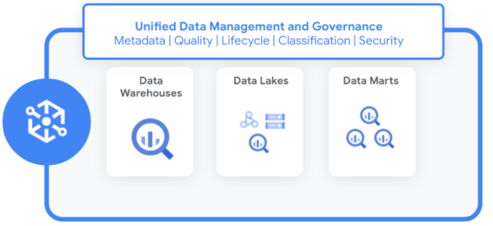
Unification
Data warehouse: is a system that aggregates data from multiple sources into a single, central, consistent data store to support artificial intelligence (AI) and machine learning.
Data marts: is a subset of a data warehouse focused on a particular line of business, department, or subject area. Data marts make specific data available to a defined group of users, which allows those users to quickly access critical insights without wasting time searching through an entire data warehouse.
Data lake: provides massive storage of unstructured or raw data fed via multiple sources, but the information has not yet been processed or prepared for analysis. As a result of being able to store data in a raw format, data lakes are more accessible and cost-effective than data warehouses.

Slide 85
Kubernetes

Slide 86
Kubernetes
Kubernetes is an open source container orchestration platform developed and open-sourced by Google in 2014. Kubernetes has since become the de facto standard for container orchestration, due to its popularity among users, the flexibility it confers to them, the support it has gained from cloud computing and software vendors, and the degree of portability it offers between on-premises and public cloud environments. It provides a powerful declarative API to run applications in a group of Docker hosts, called a Kubernetes cluster.
Kubernetes will allocate the hosts, start the containers, monitor them, and start a new instance if one of them fails. Finally, the major cloud providers all provide managed Kubernetes services; users do not even have to install and maintain Kubernetes itself. If an application or a model is packaged as a Docker container, users can directly submit it, and the service will provision the required machines to run one or several instances of the container inside Kubernetes.

Slide 87
Kubernetes
Docker with Kubernetes can provide a powerful infrastructure to host applications, including ML models. Leveraging these products greatly simplifies the implementation of the deployment strategies—like blue-green deployments or canary releases— although they are not aware of the nature of the deployed applications and thus can’t natively manage the ML performance analysis.
Another major advantage of this type of infrastructure is the ability to easily scale the model’s deployment.

Slide 88
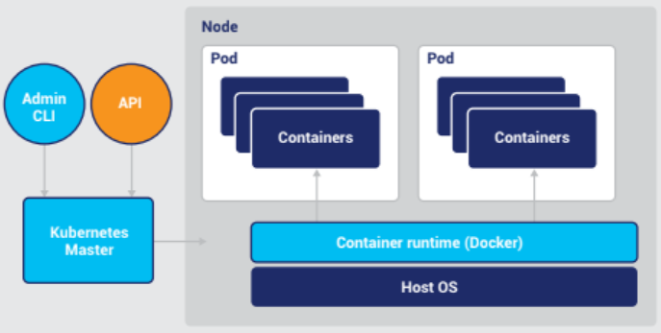
Kubernetes architecture
Kubernetes takes a hierarchical approach to managing the various resources that it is responsible for, with each layer hiding the complexity beneath it.
The highest-level concept in Kubernetes is the cluster. A Kubernetes cluster consists of at least one Kubernetes Master which controls multiple worker machines called nodes. Clusters abstract their underlying computing resources, allowing users to deploy workloads to the cluster, as opposed to on particular nodes.

Slide 89
Kubernetes architecture
A pod is a collection of one or more containers that share common configuration and are run on the same machine. It is the basic workload unit in Kubernetes. All containers within a pod share the same context, resources, and lifecycle. Resources include local and remote storage volumes and networking. All containers in a pod share an IP address and port space. To run containers in pods, Kubernetes uses a container runtime, such as Docker, running on each node.

Slide 90
Kubernetes architecture
The master can be thought of as the “brain” of the cluster. It responds to cluster configuration and management requests submitted via the Kubernetes client or API. It is responsible for determining which pods are deployed to which nodes based on their respective requirements and capabilities, a process called scheduling.
Nodes in a Kubernetes cluster run an agent called the kubelet that listens for instructions from the master and creates, runs, and destroys containers accordingly.

Slide 91
Kubernetes architecture
The user provides a plan that defines which pods to create and how to manage them. This plan can be specified via configuration documents which are sent to the cluster via Kubernetes’ APIs or client libraries. In this way, Kubernetes is said to be a “declarative” system; users declare the state of the system they want, and Kubernetes tries to affect that state given the resources at its disposal.
When pods are scheduled to a node, the node pulls the appropriate container images from an image registry and coordinates with the local container runtime to launch the container.

Slide 92
Kubernetes for Machine and Deep Learning
Simplifying Data Management
Kubernetes provides connectors for diverse data sources and manages volume lifecycle
Data workflow & pipeline abstractions allow complex data transformations
Data fabrics extend scalable, multi-format storage to cluster
Driving Efficient Resource Use
Provides elasticity, allowing cluster and workloads to be easily scaled up/down
Users and tools can programmatically deploy and control workloads
Hiding Complexity
Containers provide a convenient format for packaging workloads and declaring dependencies
Kubernetes abstracts infrastructure, allowing users to think of cluster as unit of compute

Slide 93
Kubeflow
Kubeflow has since published a general availability (GA) release of the project, and now aspires to support a wide variety of end-to-end machine learning workflows on Kubernetes.
Kubeflow is an open source project designed to make machine learning workflows on Kubernetes simple, portable and scalable. Kubeflow is sponsored by Google and inspired by TensorFlow Extended, or TFX, the company’s internal machine learning platform.
Kubeflow provides a central dashboard through which users can access and manage the various components of a Kubeflow deployment, support for multi-tenancy and multi-user isolation, and through Kubeflow Fairing, the ability to more easily build, train, and deploy training jobs across a hybrid cloud environment directly from a Jupyter notebook.

Slide 94
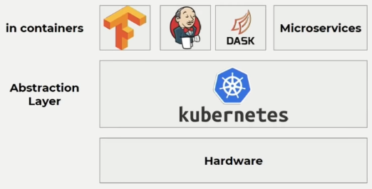
Example Kubernetes (k8s)
k8s is basically an abstraction between your hardware and whatever you want to run (Dask, microservices, TensorFlow jobs, Jenkins).
k8s doesn’t really care what is it running in most cases. It only ran containers. It doesn’t really care what’s inside these containers and that’s the good thing about it that you can have multiple workloads of different types running on the same cluster.
Complete example: https://www.youtube.com/watch?v=fYGu1ideQkw

Slide 95
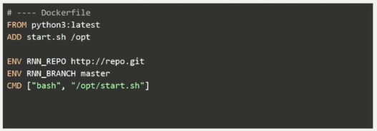
Example Kubernetes (k8s)
We need 2 things:
Dockerfile, which is basically the definition of the container.
you cloned the TensorFlow graph alongside the config file that you have, you install the dependencies, and then you basically start the tuning.

Slide 96
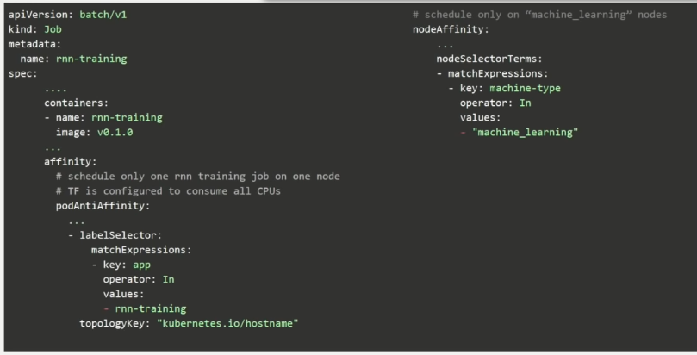
Example Kubernetes (k8s)
We need 2 things:
k8s config, which is basically a deployment file that we use in order to tell k8s what to do in this case. What should be the scheduling constraints, what should be the scheduling features that we interested in to run this job.

Slide 97
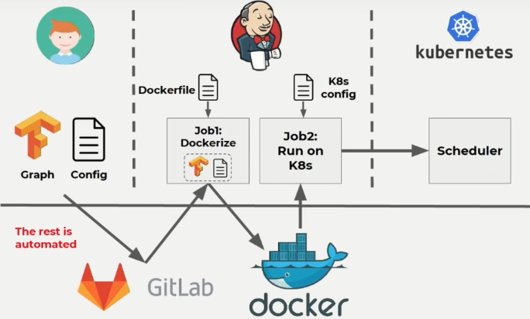
Example Kubernetes (k8s)
We see Jenkins, which just scheduled a job to kubernetes.
Initially we have a TensorFlow Graph and a Config file, and we push in the GitLab. And the rest in GitLab is basically automated.
Now we have a job which pulls in the Docker file and builds the Docker image. This also contains the dependencies, the TensorFlow Graph.

Slide 98
Example Kubernetes (k8s)
After we build a Docker image, that we push to a Docker Registry, and then this is pulled by k8s alongside a deployment file, in order to start this in k8s.
Keep in mind we have everything documented so we have the docker file, the deployment file, everything is saved so we can reproduce whatever the data scientist has done and if these models are versioned then we have can backtrack the whole process basically.

Slide 99
Example Kubernetes (k8s)
Recap: data scientist modeling and the operations is being done automatically behind the scenes by using tools like Docker, K8s and Jenkins to do the scheduling to fire this jobs. And managing environment using k8s because these environment are pre-build as docker images and you can have reproduce ability in the sense of you can trace back what happened by checking and get what the data scientist have just pushed and what Jenkins has just scheduled.

Slide 100
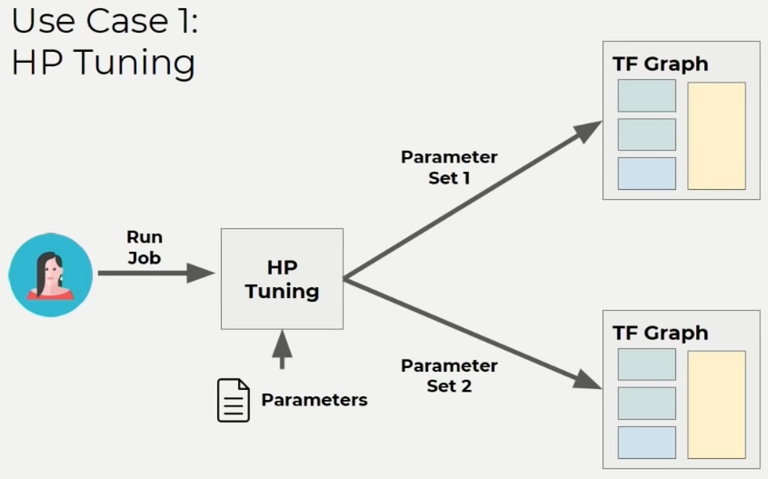
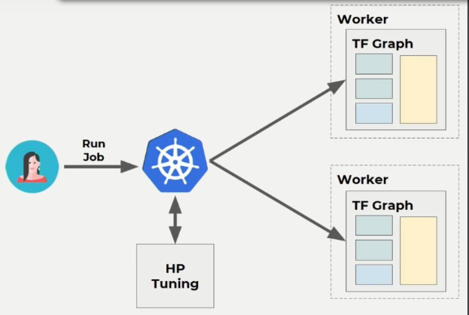
Example Kubernetes (k8s)
We check the scalable solution, for having to use more hw.
We have the Hyperparameter tuning solution: which means that you get set of parameters and then you start different tunes with distinct set of parameters
We have also KubeFlow: which separates the TensorFlow graph between different nodes (machines). Embedding the Hyperparameters tuning training logic within the kubernetes scheduler. K8s as a API that everyone can use and the scheduler has an API. You can write your scheduler in 10 lines of bash that can know where and when to run the next tune run on a separate machine.

Slide 101
DVC vs Kedro

Slide 102
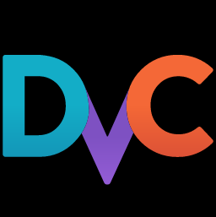
DVC
DVC - Data Version Control
It takes on a Git-like model to provide management and versioning of datasets and machine learning models. DVC is a simple command-line tool that makes machine learning projects shareable and reproducible.
Git-compatible
DVC runs on top of any Git repository and is compatible with any standard Git server or provider (GitHub, GitLab, etc).
Metric tracking
DVC includes a command to list all branches, along with metric values, to track the progress or pick the best version.

Slide 103

Kedro
Kedro is an open-source Python framework for creating reproducible, maintainable and modular data science code.
Kedro is a bridge between machine learning and software engineering.
Kedro is a template for new data engineering and data science projects
Kedro-Viz
It is a interactive visualization of the entire pipeline. It is a tool that can be very helpful for explaining what you're doing to people.
Key terms:
Data Catalog
It is a YAML API for reference datasets. the data sets can be in cloud storage or can be local. It makes the datasets declarative, rather than imperative. So all the informations related to a dataset are highly organized.
Node
It is a Python function that accepts input and optionally provides outputs.
Pipeline
It is a collection of nodes. It is a DAG (Directed acyclic graph).

Slide 104
Data Management
data/data.xml.dvc
DVC stores information about the added file in a special .dvc file named data/data.xml.dvc, this metadata file is a placeholder for the original data.
conf/base/catalog.yml
Data Catalog, which is the registry of all data sources available for use by the project.
directory /data
where the data are divided during project.
where are saved also models, plot and other created.

Slide 105
ML Pipeline
dvc.yaml file
It includes information about the steps of pipeline, with dependencies and outputs, and concatenate the nodes or pipeline.
command: dvc dag
To visualize the pipeline structure.
src/name_kedro_project/pipelines/name_pipeline/pipeline.py file
It includes information about the steps of pipeline, with dependencies and outputs, and concatenate the nodes or pipeline.
command kedro viz
this command should open up a visualisation in your browser. To visualize the pipeline structure and other informations

Slide 106
Metrics Tracking
DVC makes it easy to track metrics, and visualize performance with plots.
command: dvc run
Show node of pipeline and dependencies, create in output plots and a file with metrics.
command show diff
show difference through metrics different, for example metrics of different branches
command kedro viz
To visualize same data, for example MetricsDataSet and PlotlyDataSet and other informations.

Slide 107
Experiments
DVC can track the experiments, list and compare their most relevant metrics, parameters.
command kedro viz
Experiment tracking in Kedro-Viz also supports the display of plots, such as Plotly and Matplotlib, and other results from all experiments.

Slide 108
Parameters
params.yaml
DVC can track parameters, that can be any values used inside your code to influence the results.
command: dvc params diff
Show changes in dvc params between commits in the DVC repository
parameters/name_pipeline.yaml
Where are write parameters, that can be any values used inside your code to influence the results.

Slide 109
Plots
DVC have a set of commands to create, visualize and compare data sets.
command kedro viz
Kedro-Viz show the plot of data in output of PlotlyDataSet and Matplotlib nodes.

Slide 110
Other
DVC on VS Code
There are a DVC extension, which brings a full machine learning experimentation platform to Visual Studio Code. With this extension in VisualCode can have Interactive plots, Live tracking and Experime
More: https://iterative.ai/blog/DVC-VS-Code-extensionnt bookkeeping
Kedro-Viz
The same feature of DVC extension for Visual Studio Code are also in the browser opened by command "kedro viz".

Slide 111
Conclusion
DVC and Kedro are two tools very similar. Bookkeeping.
But:
DVC work very well with GitHub actions, because more of features are based on command-lines. This allows easy comparisons between branches of a GitHub project.
Kedro-Viz open a browser page with all pipeline, that include node and input/output data. For all these is write the corrispective path and command-line for show or run. Kedro-Viz show in a easy way also plot, metrics and show experiments history.

Slide 112
References

Slide 113
MLOPS
https://www.techopedia.com/definition/34071/machine-learning-engineer-mle
https://neptune.ai/blog/mlops
https://click.cloudcheckr.com/rs/222-ENM-584/images/CloudCheckr-White-Paper-The-Cloud-Infrastructure-Report-2020.pdf
https://ml-ops.org
https://services.google.com/fh/files/misc/ai_adoption_framework_whitepaper.pdf
https://www.datamesh-architecture.com/
https://cloudpricingcalculator.appspot.com/
https://adr.github.io/
https://www.ibm.com/uk-en/analytics/business-intelligence
https://cloud.google.com/dataplex/docs/introduction
Book
Introducing MLOps How to Scale Machine Learning in the Enterprise (Mark Treveil, Nicolas Omont, Clément Stenac etc.)
Kubernetes for MLOps - Scaling Enterprise Machine Learning, Deep Learning, and AI (Sam Charrington)
Youtube
https://www.youtube.com/watch?v=fYGu1ideQkw

Slide 114
DVC, Kedro
https://kedro.readthedocs.io/en/stable/index.html
https://dvc.org/doc/start

